Slide 1

DETECTION & RECOGNITION
UNIT-3 INTRODUCTION

Slide 2
UNIT-3 INTRODUCTION
Padding & Edge Detection,
Strided Convolutions,
Networks in Networks and 1x1Convolutions,
Inception Network Motivation,
Object Detection,
YOLO Algorithm.

Slide 3
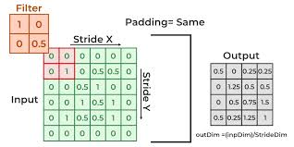
UNIT-3 Padding & Edge Detection
Padding in image processing refers to the technique of adding extra pixels (usually with a constant value such as zero or another constant) around the edges of an image.
This is often done to ensure that certain operations, such as convolution or filtering, can be applied to all parts of the image, including the borders.

Slide 4
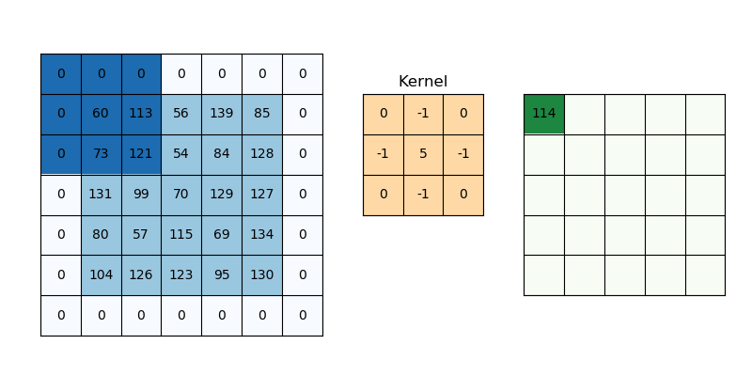
UNIT-3 Padding & Edge Detection

Slide 5
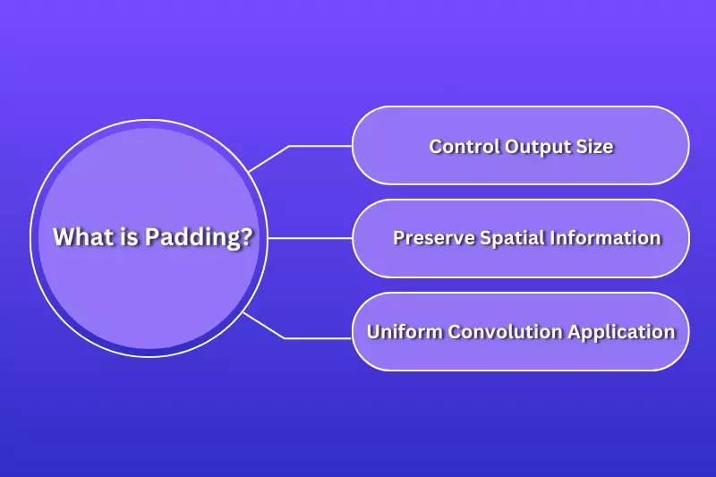
UNIT-3 Padding

Slide 6
UNIT-3 Padding
Padding in the context of Convolutional Neural Networks (CNNs) involves adding extra pixels or values around the boundaries of an image or feature map before performing convolution operations.
This additional padding helps in several ways:
‍Control Output Size: Padding allows us to control the spatial dimensions of the output feature maps after applying convolutional layers. It ensures that the output size can be adjusted according to the requirements of the network architecture.
Preserve Spatial Information: By adding padding, we can prevent the loss of spatial information that would otherwise occur at the edges of the image. This is crucial for maintaining the integrity of features extracted by convolutional filters across the entire image.
Uniform Convolution Application: Padding ensures that convolution filters are applied uniformly to all pixels of the image, including those at the edges. This uniform application helps in learning effective feature representations without biases towards certain parts of the input.

Slide 7
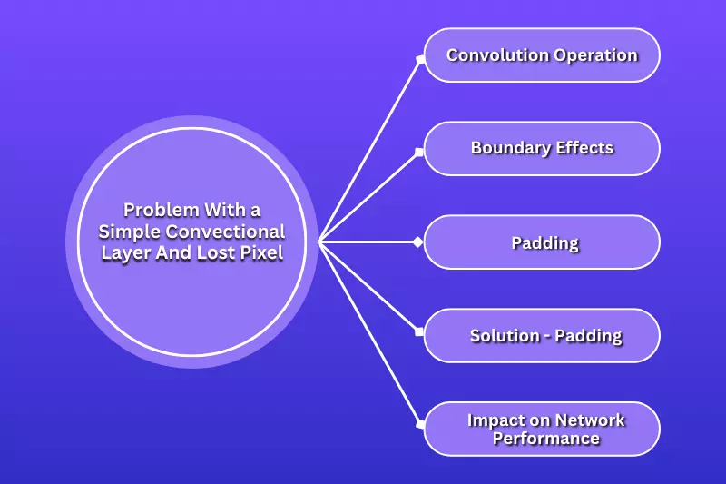
UNIT-3 Problem With a Simple Convectional Layer And Lost Pixel

Slide 8
UNIT-3 Problem With a Simple Convectional Layer And Lost Pixel
In a convolutional layer of a neural network, issues such as "lost pixels" typically arise due to the way convolution operations are applied to the input data. Here's a breakdown of what might be happening and how it can lead to lost pixels:
‍Convolution Operation: In a convolutional layer, a filter (also known as a kernel) slides over the input data (which could be an image or a feature map from a previous layer). At each position, the filter computes a weighted sum of the input values it overlaps with, producing a single value in the output feature map.
Boundary Effects: When the filter moves over the input, its effective region of influence is limited by its size. For example, a 3x3 filter covers a 3x3 region of the input. As the filter slides across the input, it computes outputs for positions where the filter can fully overlap with the input.
Padding: The issue of "lost pixels" often arises due to the absence of padding in the convolution operation. If no padding is applied (known as "valid" padding), the filter cannot be centered on pixels near the edges of the input, as there aren't enough surrounding pixels to apply the filter fully. This results in a smaller output feature map compared to the input, effectively losing information (pixels) at the edges of the image.
Solution - Padding: To mitigate this issue, padding can be applied around the input. Zero-padding is a common technique where extra rows and columns of zeros are added to the input image before applying convolution. This ensures that the filter can be centered on pixels near the edges, allowing for the computation of outputs for these positions as well.
Impact on Network Performance: Lost pixels due to lack of padding can lead to a decrease in the effectiveness of the neural network. Information at the edges of the image might be critical for accurate feature extraction, especially in tasks like object detection or image segmentation, where the spatial integrity of the image is crucial.

Slide 9
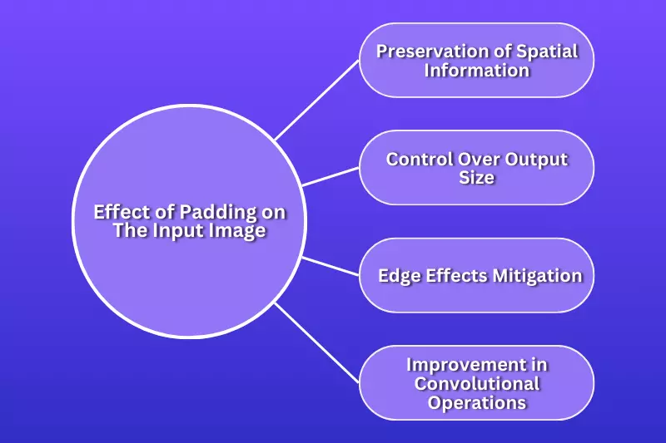
UNIT-3 Effect of Padding on The Input Image

Slide 10
UNIT-3 Problem With a Simple Convectional Layer And Lost Pixel
Padding in Convolutional Neural Networks (CNNs) involves adding extra pixels (often zeros) around the edges of an input image or feature map. It's crucial for preserving spatial information, controlling output size, and ensuring effective convolution operations in neural networks.
‍Preservation of Spatial Information: When an image is padded, extra pixels (usually zeros) are added around its borders before convolution is applied. This ensures that the spatial dimensions of the input are maintained throughout the convolutional layers. Without padding, the information at the edges of the image might be underrepresented in the output feature maps due to the convolution operation only being applied where the filter and input fully overlap.
Control Over Output Size: Padding allows control over the size of the output feature maps. For example, with the 'same' padding, the output feature map will have the same spatial dimensions as the input image, which can be advantageous in architectures where preserving spatial information is crucial.
Edge Effects Mitigation: Without padding ('valid' padding), the edges of the input image would not be processed by the convolutional filter, potentially leading to loss of information or features at the boundaries. The padding ensures that the filter can be applied to all pixels of the image, including those at the edges, which is important for tasks requiring accurate spatial localization of features, such as object detection.
Improvement in Convolutional Operations: Padding facilitates more efficient and effective convolutional operations by ensuring that the filter is applied uniformly across the entire input image. This uniform application helps in learning robust features from all parts of the image, enhancing the overall performance of the CNN.

Slide 11
UNIT-3 How Does Padding Work
Padding works by adding extra pixels or values around the edges of an input image or feature map before applying operations such as convolution or pooling in neural networks. Here’s how padding typically operates:
‍1. Types of Padding:
Zero Padding: Adds zeros around the borders of the input.
Reflective Padding: Mirrors the edge pixels of the input.
Circular Padding: Wraps the input around in a circular manner.
2. Purpose:
Preservation of Spatial Dimensions: Without padding, each convolution or pooling operation reduces the spatial dimensions of the input. Padding ensures that the spatial size remains unchanged after these operations.
Edge Handling: Padding ensures that the edge pixels of the input are equally treated as interior pixels. This avoids the potential loss of information at the boundaries of the input.‍
3. Calculation:
The amount of padding added can be calculated based on the desired output size and the size of the convolutional filter or pooling window.
For example, in "same" padding, the padding size PPP is typically set such that the output size matches the input size.
4. Implementation:
In practice, padding is applied using various libraries and frameworks that support neural network operations (e.g., TensorFlow, PyTorch).
The padding is added before passing the input through convolutional or pooling layers, ensuring that subsequent operations consider the padded input dimensions.

Slide 12
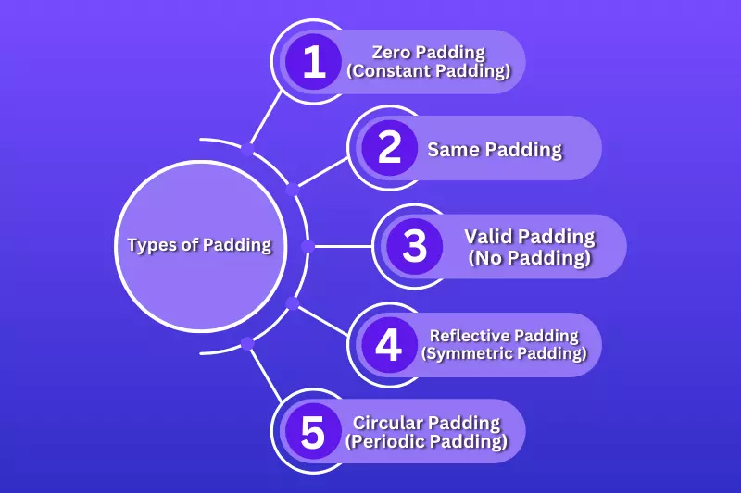
UNIT-3 Type of Padding

Slide 13
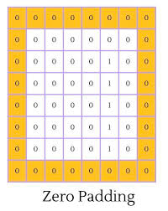
UNIT-3 Type of Padding
1. Zero Padding (Constant Padding):
Zero padding involves adding zeros (or any constant value) around the borders of the input image or feature map.
For a 2D input, if you want to add P pixels of zero padding around all edges, the resulting size of the padded input will be (H+2P)×(W+2P)(H + 2P) \times (W + 2P)(H+2P)×(W+2P), where H and W are the original height and width of the input.
‍‍

Slide 14
UNIT-3 Type of Padding
‍2. Same Padding:
Same padding is a specific type of zero padding where the output feature map has the same spatial dimensions as the input.
The amount of same padding PPP can be calculated for a convolutional layer with filter size F and stride S as P=(F−1)2P = \frac{(F - 1)}{2}P=2(F−1)​.
Same padding ensures that the convolutional operation is applied uniformly across the input image, including the edges.
3. Valid Padding (No Padding):
Valid padding means no padding is added to the input.
The convolution operation is only performed where the input and the filter fully overlap, resulting in an output feature map that is smaller than the input.
This type of padding is often used when reducing the spatial dimensions of the input is desired, such as in downsampling operations.
‍

Slide 15
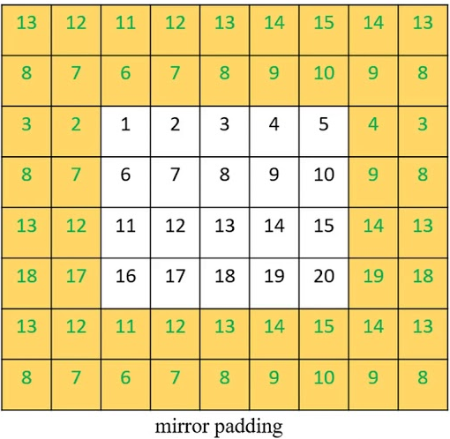
UNIT-3 Type of Padding
4. Reflective Padding (Symmetric Padding):
Reflective padding mirrors the input values at the edges.
It pads the input with copies of the input mirrored along the edges.
Reflective padding can be useful when the content of the input image or feature map has a repeating pattern or symmetry.
‍

Slide 16
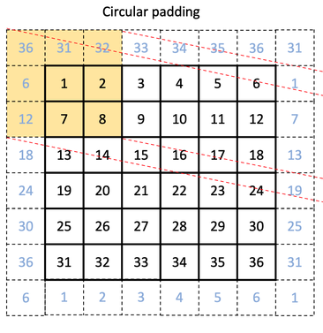
UNIT-3 Type of Padding
‍
5. Circular Padding (Periodic Padding):
Circular padding wraps the input around, creating a circular boundary.
It can be useful in certain applications where the input data has periodic or circular properties, such as processing signals or time-series data.

Slide 17
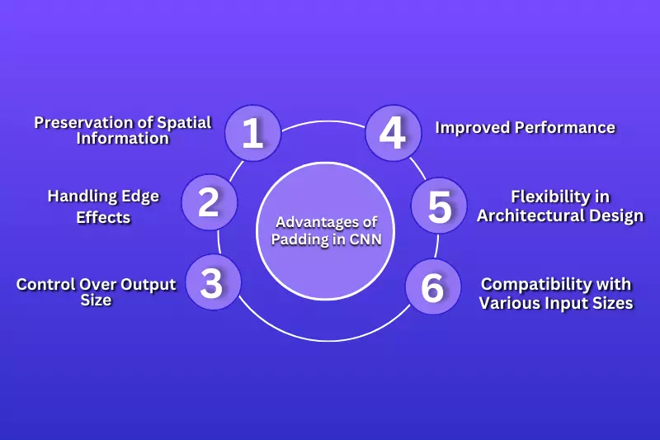
UNIT-3 Advantages of Padding in CNN

Slide 18
UNIT-3 Advantages of Padding in CNN
Preservation of Spatial Information: By padding the input data, CNNs maintain the spatial dimensions throughout the layers. This ensures that information at the edges of the input, which is often critical for accurate feature extraction, is not lost during convolution operations.
Handling Edge Effects: Padding mitigates edge effects that occur when convolutional filters do not fully overlap with the input at the edges. This prevents artifacts or inaccuracies in feature maps that could arise from incomplete convolution operations.
Control Over Output Size: Different padding strategies (e.g., same padding) allow control over the size of the output feature maps. This control is essential for designing network architectures and managing computational resources effectively, especially in tasks where input and output dimensions need to be consistent.
Improved Performance: Properly applied padding facilitates more effective and robust feature extraction. By ensuring that all parts of the input are treated equally, padding enhances the network's ability to learn meaningful features from diverse spatial patterns in the data.
Flexibility in Architectural Design: Padding provides flexibility in designing CNN architectures. It allows researchers and practitioners to experiment with different configurations while maintaining the integrity of spatial information and optimizing performance metrics such as accuracy and convergence speed.
Compatibility with Various Input Sizes: With padding, CNNs can process inputs of varying sizes without requiring resizing or cropping. This versatility is particularly advantageous in applications involving images or other spatial data of different dimensions.

Slide 19
References
https://www.fynd.academy/blog/padding-in-cnn
Code for Padding: https://colab.research.google.com/drive/1BomVx0WGi-_zH1nVkwlX3_wAsU-PHBq6#scrollTo=q1VLnHYyk0fb

Slide 20
Strided Convolutions
In a typical convolution operation, we slide a filter (kernel) over the input image (or matrix) one step at a time. The "stride" determines how much we move the filter with each step.
Stride of 1 means the filter moves by one unit at a time.
Stride of 2 means the filter moves by two units at a time, and so on.
Why Strided Convolutions?
Strided convolutions are used to control the spatial resolution of the output feature map. A larger stride results in a smaller output size, which is useful for:
Downsampling: Reducing the spatial dimensions of the output (e.g., reducing the image size).
Faster computation: A larger stride reduces the number of calculations by reducing the size of the output.
Learning spatial hierarchies: When downsampling, we can capture features at multiple spatial resolutions, which is useful for capturing both fine and coarse-level features in deep networks.

Slide 21
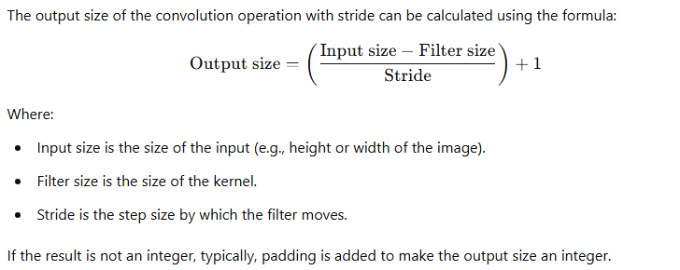
Effect of Stride on the Output Size

Slide 22
1x1 Convolutions
A 1x1 convolution is a special type of convolution where the kernel (filter) has a size of 1x1.
This might seem counterintuitive at first because, in traditional convolutions, you typically use larger kernels (e.g., 3x3, 5x5) to extract features.
However, 1x1 convolutions are incredibly useful in deep neural networks, particularly in architectures like GoogleNet (Inception), ResNet, and MobileNet.

Slide 23
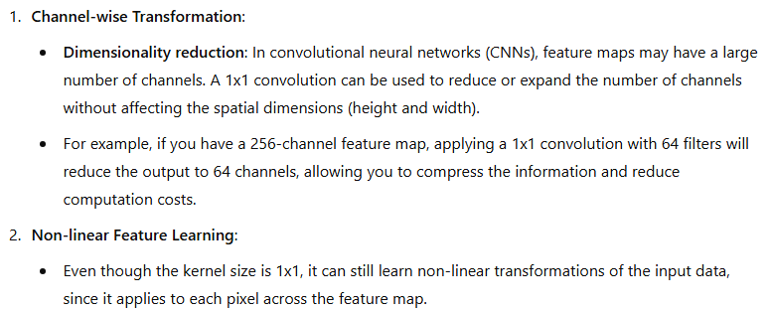
Why 1x1 Convolutions?

Slide 24
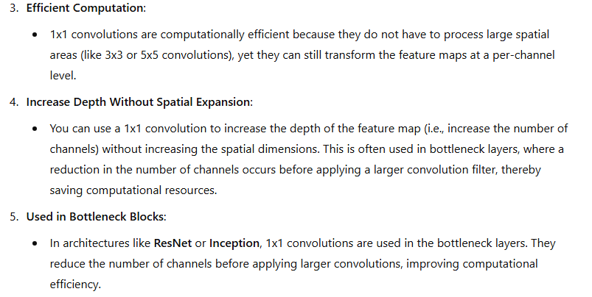
Why 1x1 Convolutions?

Slide 25
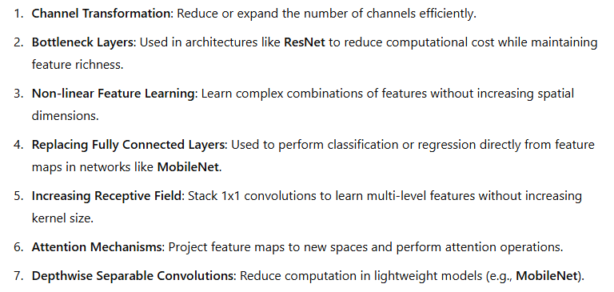
Application 1x1 Convolutions?

Slide 26
Inception Network Motivation
The Inception Network (often referred to as GoogLeNet) is a deep convolutional neural network (CNN).
It was introduced by Google researchers in 2014.
It won the ILSVRC 2014 (ImageNet Large Scale Visual Recognition Challenge) by achieving the top classification accuracy.
The Inception network introduced several innovative concepts that allow CNNs to achieve better performance with less computational cost and a more efficient use of resources.
The primary motivation behind the Inception Network was to address some of the challenges in designing deep neural networks, specifically the balance between depth, width, and computational efficiency.

Slide 27
Inception Network Motivation
The Inception Network (often referred to as GoogLeNet) is a deep convolutional neural network (CNN).
It was introduced by Google researchers in 2014.
It won the ILSVRC 2014 (ImageNet Large Scale Visual Recognition Challenge) by achieving the top classification accuracy.
The Inception network introduced several innovative concepts that allow CNNs to achieve better performance with less computational cost and a more efficient use of resources.
The primary motivation behind the Inception Network was to address some of the challenges in designing deep neural networks, specifically the balance between depth, width, and computational efficiency.

Slide 28
Key Motivations Behind the Inception Network
1. Efficient Use of Computational Resources
As neural networks become deeper and more complex, the computational cost grows significantly. Training deep CNNs with many layers results in high memory and processing demands. The Inception Network aims to mitigate this problem by optimizing the use of computational resources.
Challenge:
In conventional CNNs, deeper networks tend to have higher accuracy, but they also require more computation and memory. More filters and larger kernel sizes increase the computational cost dramatically.
Solution:
The Inception module solves this problem by using multiple convolutional filters (kernels) of different sizes in parallel within the same layer. Instead of choosing just one kernel size (e.g., 3x3), it uses:
1x1 convolutions (to capture fine-grained features).
3x3 convolutions (to capture medium-sized features).
5x5 convolutions (to capture larger-scale features).
In this approach, the network learns multi-scale features at the same layer without increasing the depth too much, and without requiring the network to train separate layers for each kernel size.
Additionally, the use of 1x1 convolutions helps reduce the dimensionality (number of channels), reducing computational costs and parameters while still allowing for the flexibility of multi-scale feature extraction.

Slide 29
Key Motivations Behind the Inception Network
1. Efficient Use of Computational Resources
As neural networks become deeper and more complex, the computational cost grows significantly. Training deep CNNs with many layers results in high memory and processing demands. The Inception Network aims to mitigate this problem by optimizing the use of computational resources.
Challenge:
In conventional CNNs, deeper networks tend to have higher accuracy, but they also require more computation and memory. More filters and larger kernel sizes increase the computational cost dramatically.
Solution:
The Inception module solves this problem by using multiple convolutional filters (kernels) of different sizes in parallel within the same layer. Instead of choosing just one kernel size (e.g., 3x3), it uses:
1x1 convolutions (to capture fine-grained features).
3x3 convolutions (to capture medium-sized features).
5x5 convolutions (to capture larger-scale features).
In this approach, the network learns multi-scale features at the same layer without increasing the depth too much, and without requiring the network to train separate layers for each kernel size.
Additionally, the use of 1x1 convolutions helps reduce the dimensionality (number of channels), reducing computational costs and parameters while still allowing for the flexibility of multi-scale feature extraction.

Slide 30
Key Motivations Behind the Inception Network
2. Multi-Scale Feature Extraction
In most traditional CNNs, filters of the same size (e.g., 3x3 or 5x5) are applied to extract features at a particular scale. This is often restrictive because objects in an image can appear at various scales, and a fixed kernel size may not be optimal for capturing all these features.
Challenge:
A single kernel size cannot effectively capture features at multiple scales (e.g., small features like edges vs large features like textures or shapes) in one layer.
Solution:
The Inception module applies multiple convolution filters (of varying sizes) in parallel at the same layer. This enables the network to learn features from multiple scales in parallel, allowing it to detect both fine details and larger objects simultaneously.
For example, in an Inception module, you could apply:
A 1x1 convolution (which focuses on very small details).
A 3x3 convolution (which focuses on medium-level features).
A 5x5 convolution (which captures broader patterns).
The outputs of all these filters are concatenated, so the network can leverage different levels of information in the same layer.

Slide 31
Key Motivations Behind the Inception Network
3. Reducing the Number of Parameters (Computational Efficiency)
Deep neural networks with many layers tend to have millions of parameters. This makes them computationally expensive and prone to overfitting, especially when training on small datasets.
Challenge:
As networks become deeper, the number of parameters (and computational complexity) increases, which can lead to inefficiency and overfitting.
Solution:
The Inception network reduces the number of parameters by using 1x1 convolutions for dimensionality reduction.
In the Inception module, before applying the larger convolutions (like 3x3 and 5x5), a 1x1 convolution is applied to reduce the number of channels.
This reduces the number of computations and parameters while still allowing the network to learn complex features.
For example, instead of directly applying a 5x5 convolution to the entire input, a 1x1 convolution is first used to reduce the number of channels, and then the 5x5 convolution is applied.
This approach significantly reduces the number of parameters and computational cost.

Slide 32
Key Motivations Behind the Inception Network
4. Avoiding Overfitting with Smaller Filters
One issue with large kernel sizes (e.g., 5x5, 7x7) is that they have many more parameters, which can lead to overfitting, especially if the dataset is small or has noisy data.
Challenge:
Large filters tend to increase the number of parameters and make the model prone to overfitting.
Solution:
The Inception network uses 1x1 convolutions (with fewer parameters) before applying larger convolutions.
The 1x1 convolutions help reduce the dimensionality of the input feature maps, so the larger filters (3x3, 5x5) are applied to a smaller and more manageable feature space, reducing the risk of overfitting.
Moreover, smaller filters allow for more effective feature extraction because they capture local dependencies (fine-grained details) and still contribute to learning large-scale features without excessive parameter growth.

Slide 33
Key Motivations Behind the Inception Network
5. Deeper and More Complex Networks with Fewer Parameters
Convolutional networks typically benefit from increasing depth (more layers), but adding more layers increases the number of parameters, computational complexity, and memory usage.
Challenge:
Simply increasing the number of layers leads to higher computational complexity and harder training, especially with a growing number of parameters.
Solution:
The Inception network uses the idea of parallel convolutions and 1x1 convolutions to learn more complex and diverse features while keeping the number of parameters lower.
This approach allows the network to go deeper and wider while avoiding excessive computational costs.
In the Inception module, by stacking convolutions of varying sizes in parallel and using 1x1 convolutions for dimensionality reduction, the network is able to perform more complex feature extraction with fewer parameters.

Slide 34
Key Motivations Behind the Inception Network
6. Incorporating Pooling in Parallel
In addition to convolutions, pooling operations (such as max pooling) are often used to reduce the spatial resolution of the input, which helps in making the network more invariant to small translations of objects.
Challenge:
Pooling operations (like max pooling) typically reduce the spatial dimensions, but this can lead to the loss of valuable information, especially in high-resolution feature maps.
Solution:
In the Inception module, pooling layers are used in parallel with convolutional layers. The outputs of the convolutions and pooling operations are concatenated, allowing the network to learn from both detailed features (from convolutions) and higher-level features (from pooling). This parallelism helps the network better capture spatial hierarchies and preserve important information.

Slide 35
Key Motivations Behind the Inception Network
7. Modular and Scalable Architecture
A major motivation behind the Inception network is creating an architecture that is modular and scalable, meaning that the same basic building block (the Inception module) can be repeated and scaled to form a deep network.
Challenge:
As networks become deeper, they may become harder to optimize and train effectively. Additionally, traditional architectures may require hard decisions on the filter sizes or the number of channels.
Solution:
The Inception module provides a flexible, modular design where different types of convolutions can be used in parallel. The depth of the network can be increased by stacking these modules, and the network can be made wider by adding more filters to each module.

Slide 36
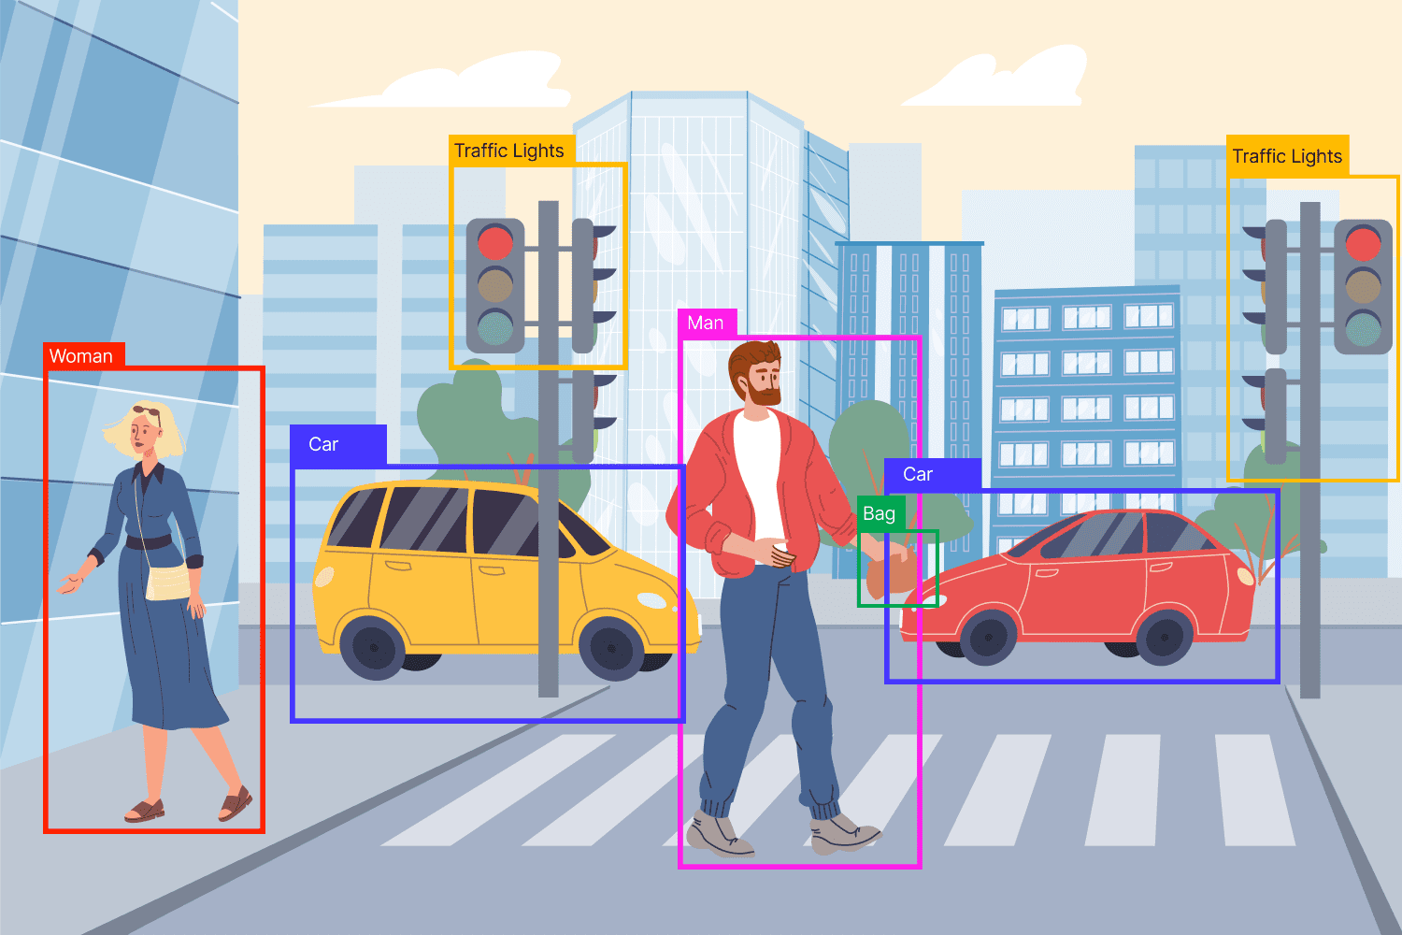
Object Detection

Slide 37
Object Detection
Object Detection is a computer vision technique that identifies and locates objects within an image or a video.
object detection also says where in the image the object is, typically by drawing a bounding box around it.
The intuition here is that, like humans, machines should have knowledge of all entities within their frame of reference. These entities may include people, animals, cars, trees, etc.
Object localization is a technique for determining the location specific objects in an image by demarcating the object through a bounding box.
Object classification is another technique that determines to which category a detected object belongs.
The object detection task combines subtasks of object localization and classification to simultaneously estimate the location and type of object instances in one or more images.

Slide 38
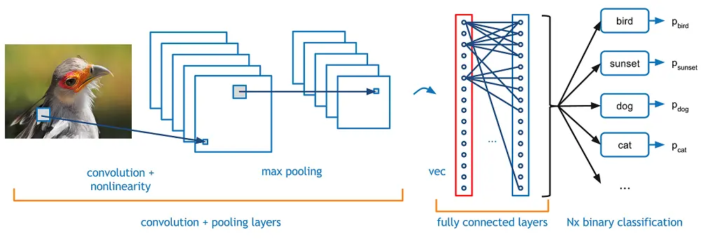
Object Detection vs. Other Tasks
Image classification: This is the prediction of the class of an item in an image. For example, when you carry out a reverse image search on Google, you are likely to receive a note that says “might include ‘x’, with the ‘x' being anything that the technology detects as the primary object of the image. Image classification can show that a particular object exists in the image, but it involves one primary object and does not provide the object’s location within the visual.

Slide 39
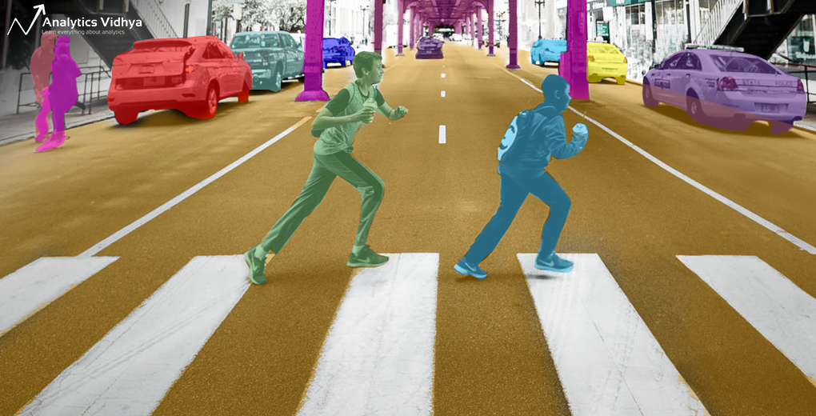
Object Detection vs. Other Tasks
Segmentation: Otherwise known as semantic segmentation, it is the task of grouping pixels with comparable properties together instead of bounding boxes to identify objects.

Slide 40
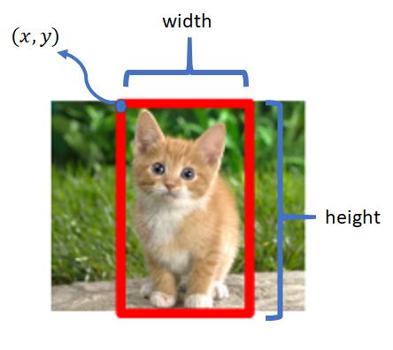
Object Detection vs. Other Tasks
Object localization: The difference with object detection is very subtle yet evident. Object localization seeks to identify the location of one or more objects in an image, whereas object detection identifies all objects and their borders without much focus on placement.

Slide 41
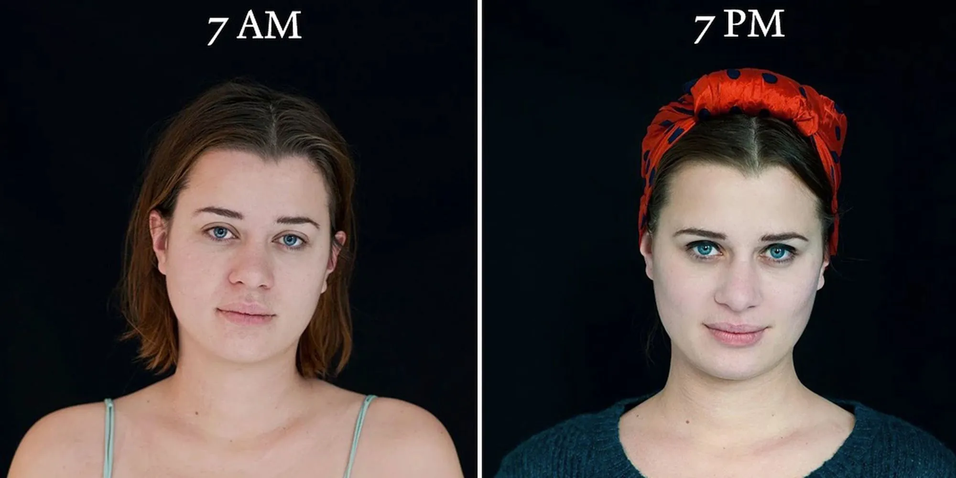
Core challenges in object detection
Variability in object appearance: Objects can appear in various sizes, shapes, and orientations within images. The same object or subject might look different under different lighting conditions, from different viewpoints, or in varied backgrounds. The ability of a model to recognize such diverse representations of an object is crucial.

Slide 42
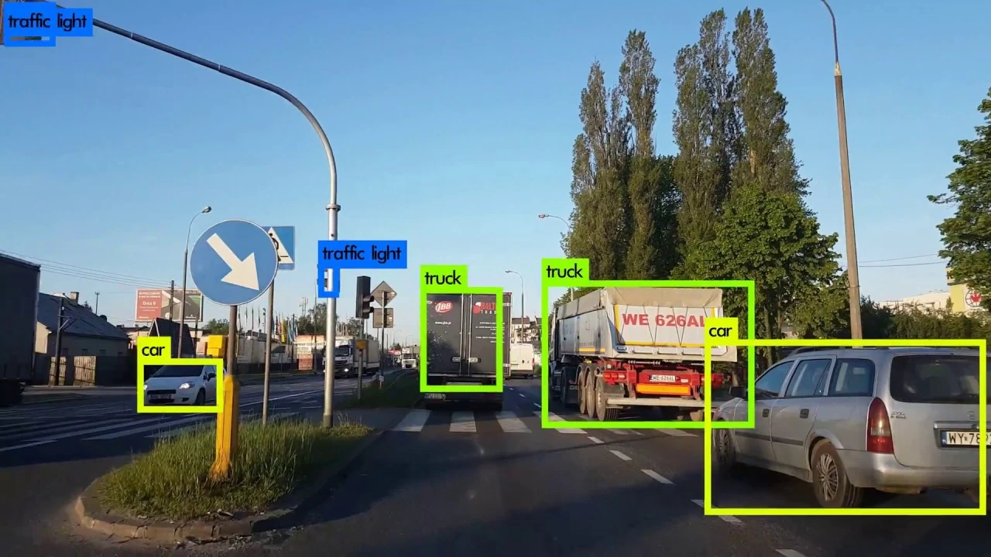
Core challenges in object detection
Scale variations: Objects in images can range from tiny to very large. Detecting both small objects (like a distant bird) and large ones (like a close-up face) in the same image requires models to be scale-invariant or operate at multiple scales.

Slide 43
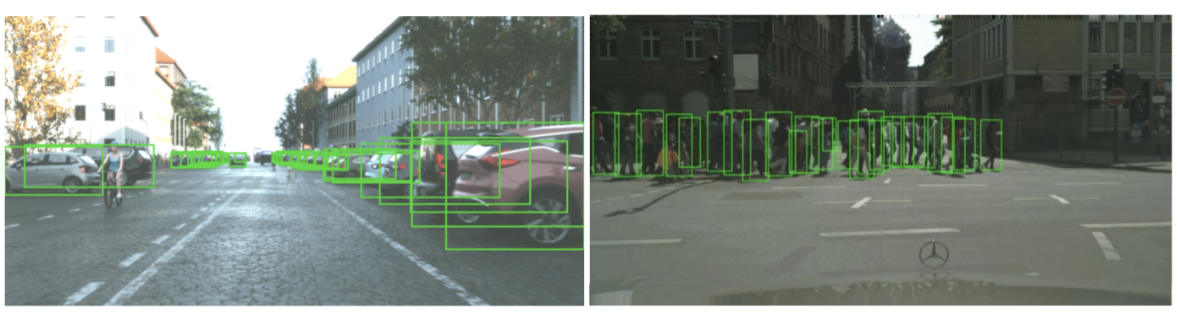
Core challenges in object detection
Occlusions: Objects of interest are often partially or largely obscured by other objects. For instance, a person standing behind a tree or a car partly hidden behind a building. Handling occlusions is pivotal for accurate object detection.

Slide 44
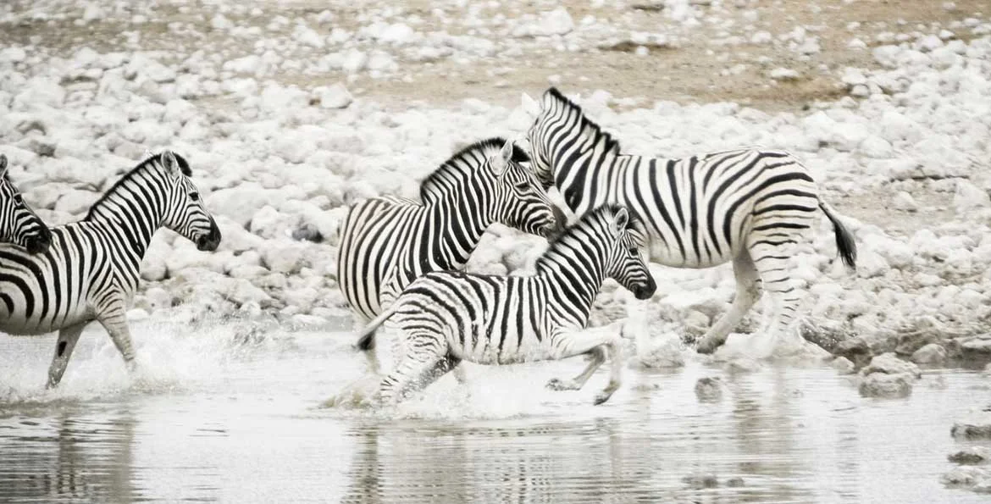
Core challenges in object detection
Background clutter: Objects might be set against backgrounds with confusing patterns or multiple overlapping objects, making it challenging to distinguish the foreground (object of interest) from the background.

Slide 45
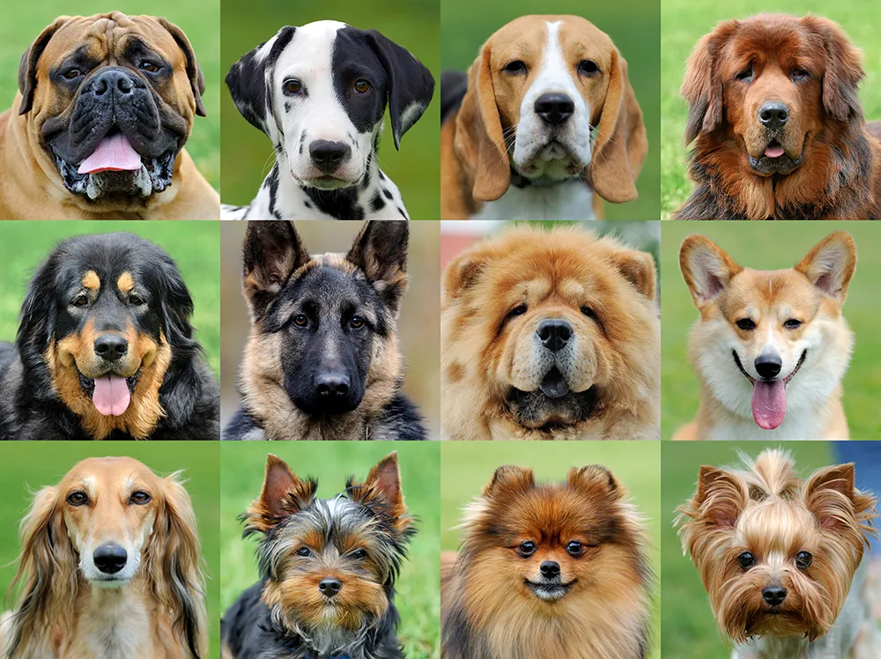
Core challenges in object detection
Intra-class variability: Objects within the same class can vary significantly in appearance. For example, the "dog" class includes diverse breeds with varied shapes and sizes. Models should generalize well across such intra-class variations.

Slide 46
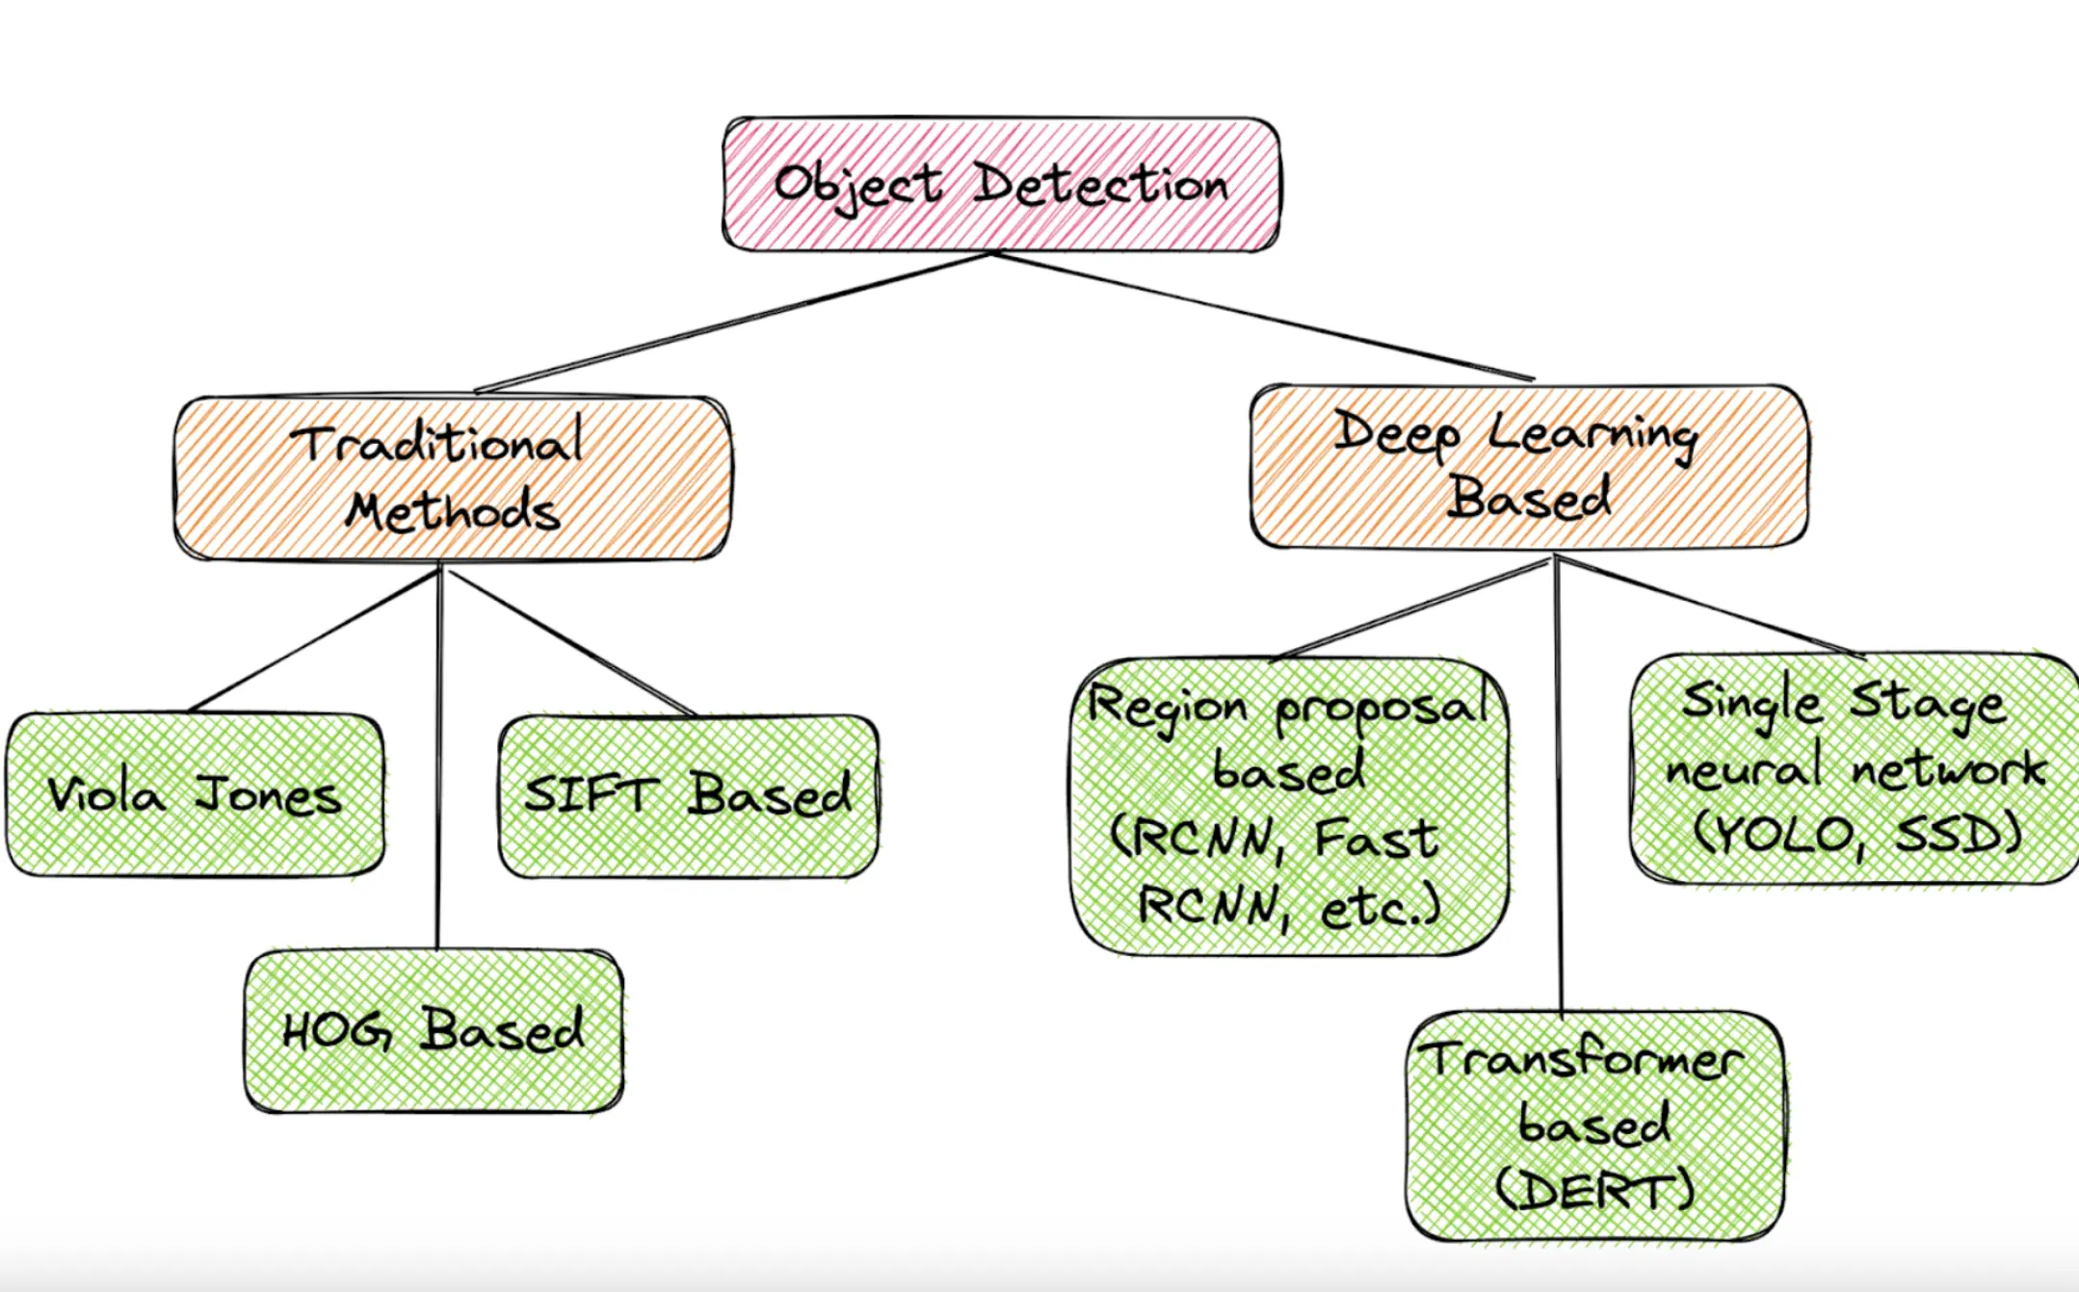
Early traditional approaches in object detection

Slide 47
Early traditional approaches in object detection
Traditional Approaches
Harris corner detector: Proposed in the 1980s, this method focused on detecting corners as interest points in an image. The idea was that corners provide a unique feature that can be reliably detected due to their distinctiveness compared to edges or flat regions.
Scale-invariant feature transform (SIFT): Developed by David Lowe in 1999, SIFT extracts and describes local image features that are invariant to scale, rotation, and affine transformations, as well as being robust to changes in illumination. SIFT features were often used to match objects or scenes between different images.
Speeded up robust features (SURF): An evolution of SIFT, SURF was designed to be faster and more efficient while retaining robustness against transformations. It was introduced in 2006 and relied on integral images to expedite feature extraction.

Slide 48
Early traditional approaches in object detection
Histogram of oriented gradients (HOG): Introduced by Navneet Dalal and Bill Triggs in 2005, HOG descriptors focus on capturing an object’s structure or shape by examining the orientation of gradients in local regions of an image. HOG became particularly popular for pedestrian detection in images.‍
Viola-Jones object detection framework: Developed in 2001 by Paul Viola and Michael Jones, this was one of the first effective real-time object detection methods. The framework utilized Haar-like features to detect objects, especially faces, in images. A cascade of classifiers was used, allowing for efficient real-time performance by quickly discarding negative samples.‍
Deformable part models (DPM): DPM, introduced by Felzenszwalb et al., was based on mixtures of multi-scale deformable part models. It represented objects by parts arranged in a deformable configuration and used HOG features. DPM was notably robust against object deformation and variability in pose.

Slide 49
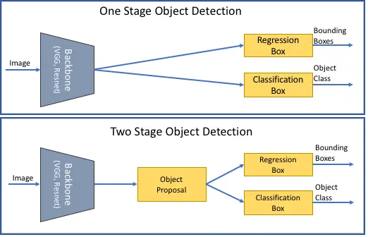
Early traditional approaches in object detection
Deep Learning Based Approaches
Early deep learning-based object detection models were categorized into two classes: one-stage and two-stage detectors.
One-stage object detectors direct prediction, eliminating completely the region proposal step.
Two-stage object detectors are composed of region proposals followed by classification and refinement of the proposal.

Slide 50
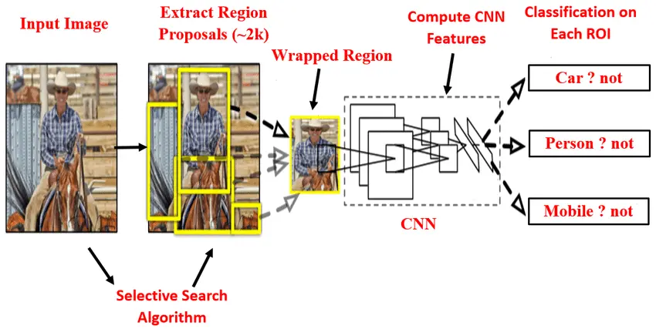
Early traditional approaches in object detection
Two Stage Object Detectors: The RCNN Family
The region-based convolutional neural network (RCNN) was proposed by Ross Girshick et al. in 2014 and
It was one of the first successful deep learning approaches to detect objects.
RCNN operates by generating a set of region proposals using an external algorithm, applying a pre-trained convolutional neural network (CNN) to each proposal to extract features, and finally classifying each proposal using a support vector machine (SVM).

Slide 51
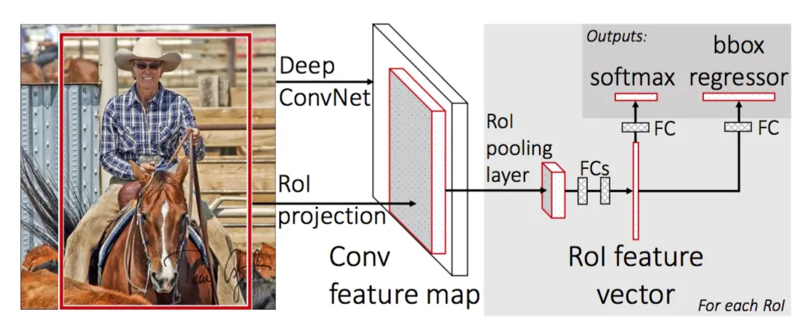
Early traditional approaches in object detection
Two Stage Object Detectors: Fast-RCNN
The fast region-based convolutional neural network (Fast R-CNN) was proposed by Ross Girshick in 2015 and
It was designed to improve the speed and accuracy of object detection.
Fast R-CNN operates by using a single shared CNN to extract features from the entire image.
Then, it uses the region of interest (RoI) pooling to extract fixed-length feature vectors for each region proposal. These feature vectors are then fed into a fully connected layer set that performs object classification and bounding box regression.

Slide 52
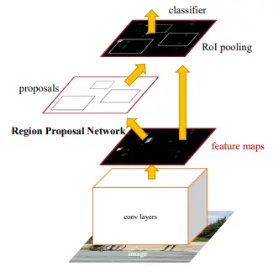
Early traditional approaches in object detection
Two Stage Object Detectors: Faster-RCNN
The faster region-based convolutional neural network (Faster R-CNN) was proposed by Shaoqing Ren et al. in 2015, representing a major breakthrough in deep learning object detection.
Faster R-CNN operates by using a region proposal network (RPN) first to generate region proposals directly from the convolutional neural network features rather than using an external algorithm.
The RPN shares convolutional layers with the object detection network, which allows it to be trained end-to-end with the rest of the network.
Faster R-CNN also introduced a new loss function that jointly optimizes object classification and bounding box regression, which helps to improve accuracy.

Slide 53

Early traditional approaches in object detection
One-stage object detectors
One-stage object detection methods aim to simplify the object detection pipeline by predicting object class labels, and bounding box coordinates in a single pass, thereby often achieving faster processing speeds than two-stage methods.
Given their efficiency, they are popular choices for real-time object detection.
Some of the prominent one-stage object detection models are YOLO, SSD, and RetinaNet, which we will introduce separately.

Slide 54
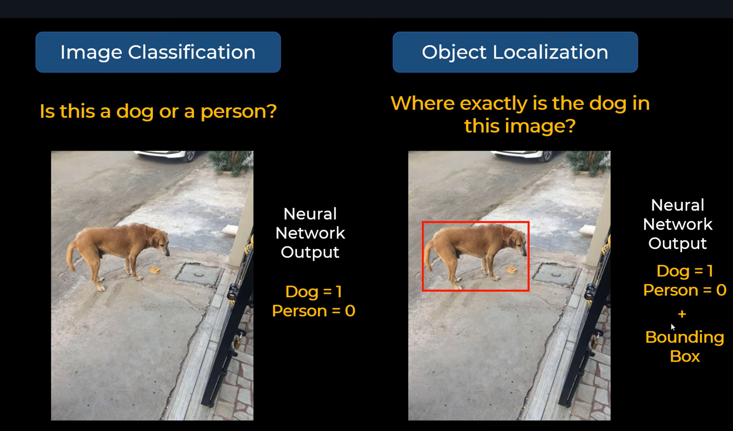
YOLO (You Only Look Once)

Slide 55
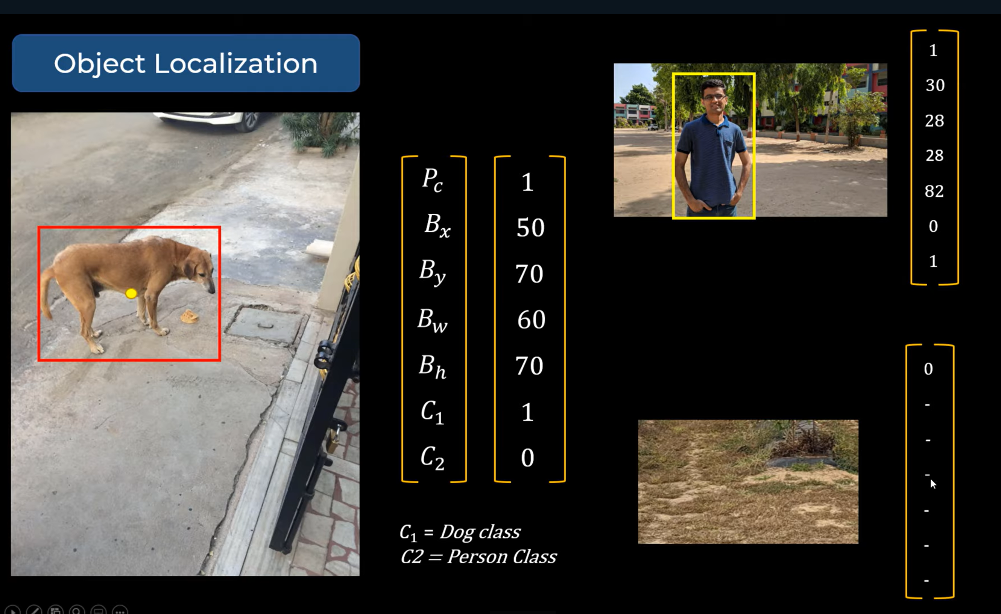
YOLO: Matrix Representation
Pc – Probability of Class
Bx, By – Centre of Image (Yellow Dot)
Bw, Bh – Width and Height of Bounding Box
C1 – Class Dog,
C2 – Class Person

Slide 56
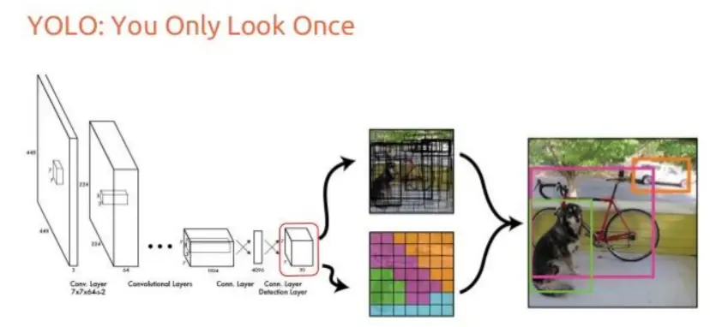
Early traditional approaches in object detection
One-stage object detectors: YOLO: You Only Look Once
YOLO divides an image into a grid and predicts bounding boxes and class probabilities for each grid cell.
Unlike sliding window and region proposal-based techniques, YOLO looks at the whole image only once, hence the name.
The original YOLO has seen multiple versions, with YOLOv2 (YOLO9000), YOLOv3, and YOLOv4 introducing various improvements in accuracy, speed, and the ability to detect a wider range of object sizes.
Its tiny versions are extremely fast, making it suitable for real-time object detection and even deployment on edge devices. Usually, it has a good balance between precision and recall.

Slide 57
Evaluating Object Detection Models
In the case of object detection, two main metrics are usually used to evaluate the models:
Intersection over union (IoU): IoU is a measure of the overlap between two bounding boxes. It is defined as the area of intersection divided by the area of union of the predicted bounding box (from the model) and the ground truth bounding box (from the dataset). You can read further about this metric in our article about IoU.‍
‍Average precision (AP): For each class, an AP score is calculated primarily by plotting the precision-recall curve and then computing the area under this curve. Then, the mean of AP scores (mAP) across all classes. A higher mAP value indicates a better overall performance of the object detection model across all object classes. We have another informative article about this metric, which you can access here.

Slide 58
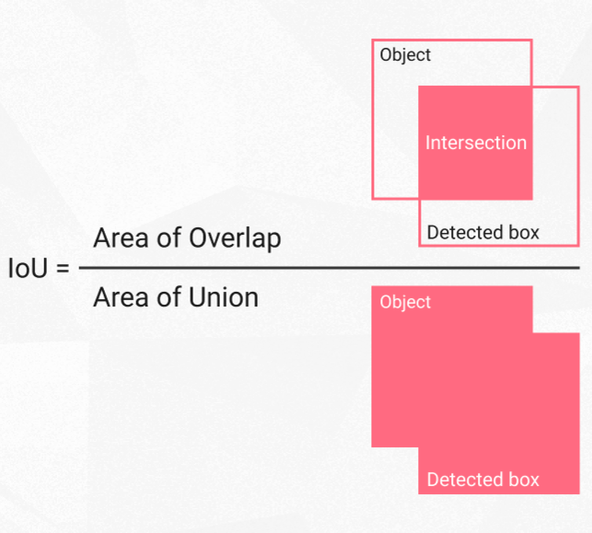
Evaluating Object Detection Models
Intersection over union (IoU):
It is based on the Jaccard index (a coefficient for similarity for two sets of data).
Given the two bounding boxes -- the predicted and ground truth ones and their areas, calculating IoU becomes a piece of cake.

Slide 59
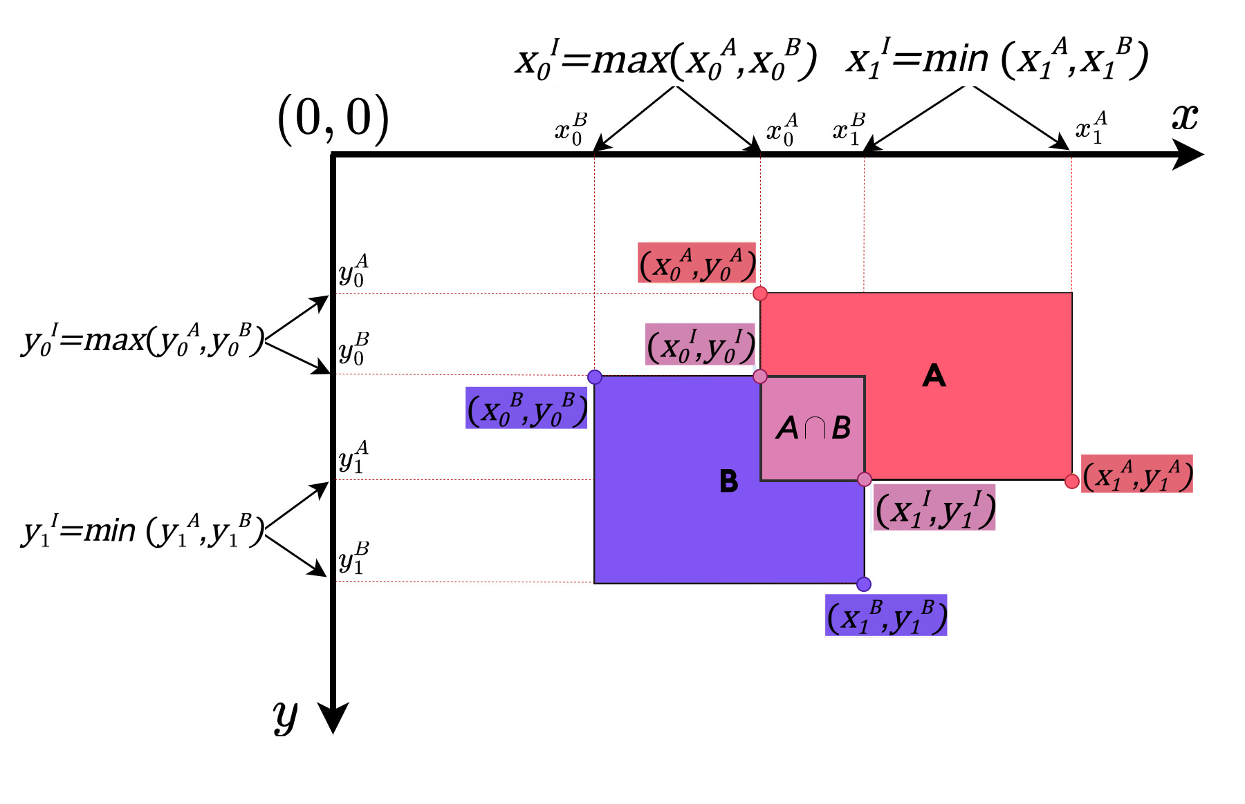
Evaluating Object Detection Models
Calculation Intersection over union (IoU):

Slide 60
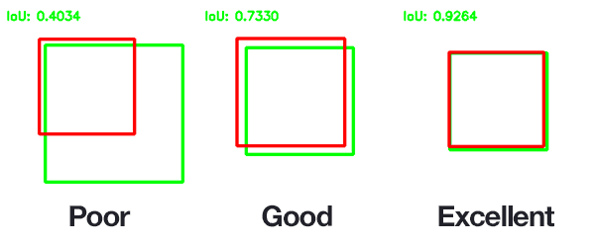
Evaluating Object Detection Models
Calculation Intersection over union (IoU):

Slide 61
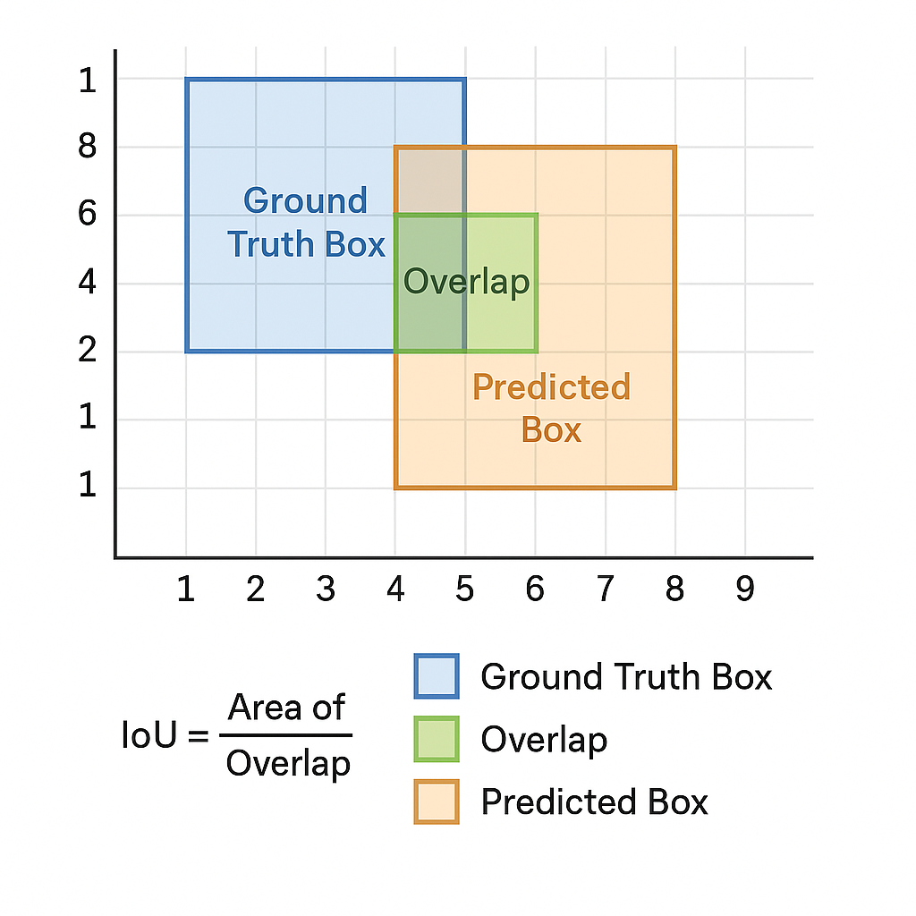
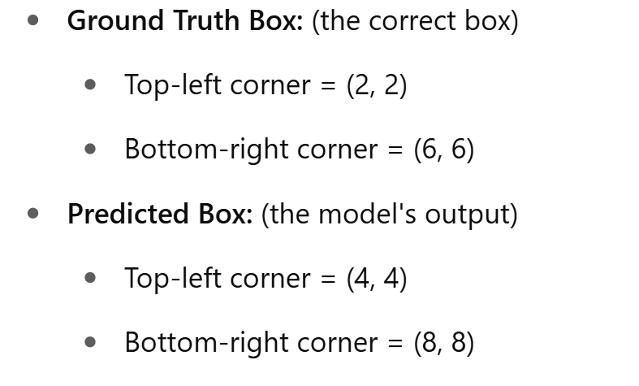
Evaluating Object Detection Models
Calculation Intersection over union (IoU) Example:

Slide 62
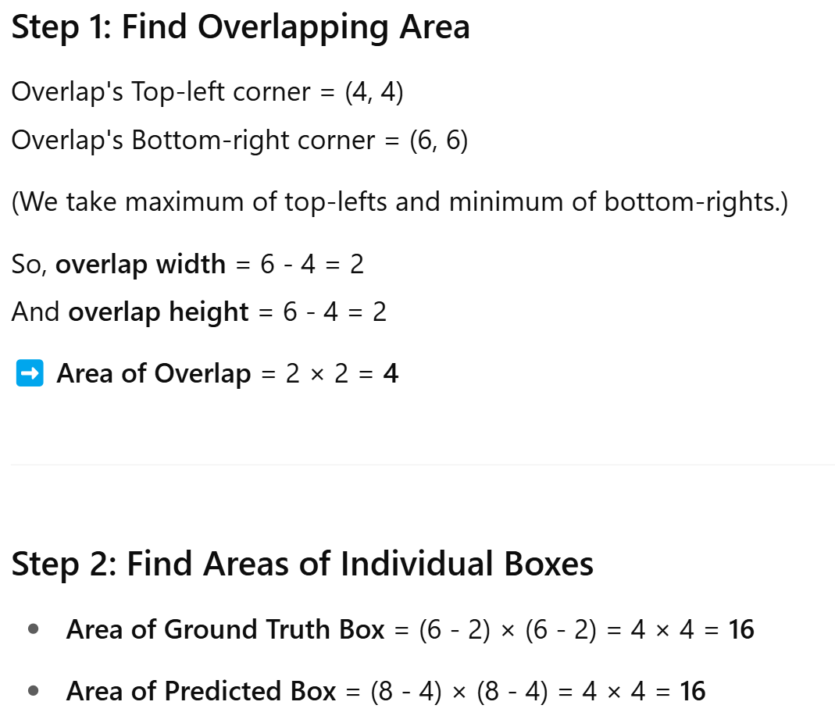
Evaluating Object Detection Models
Calculation Intersection over union (IoU) Example:

Slide 63
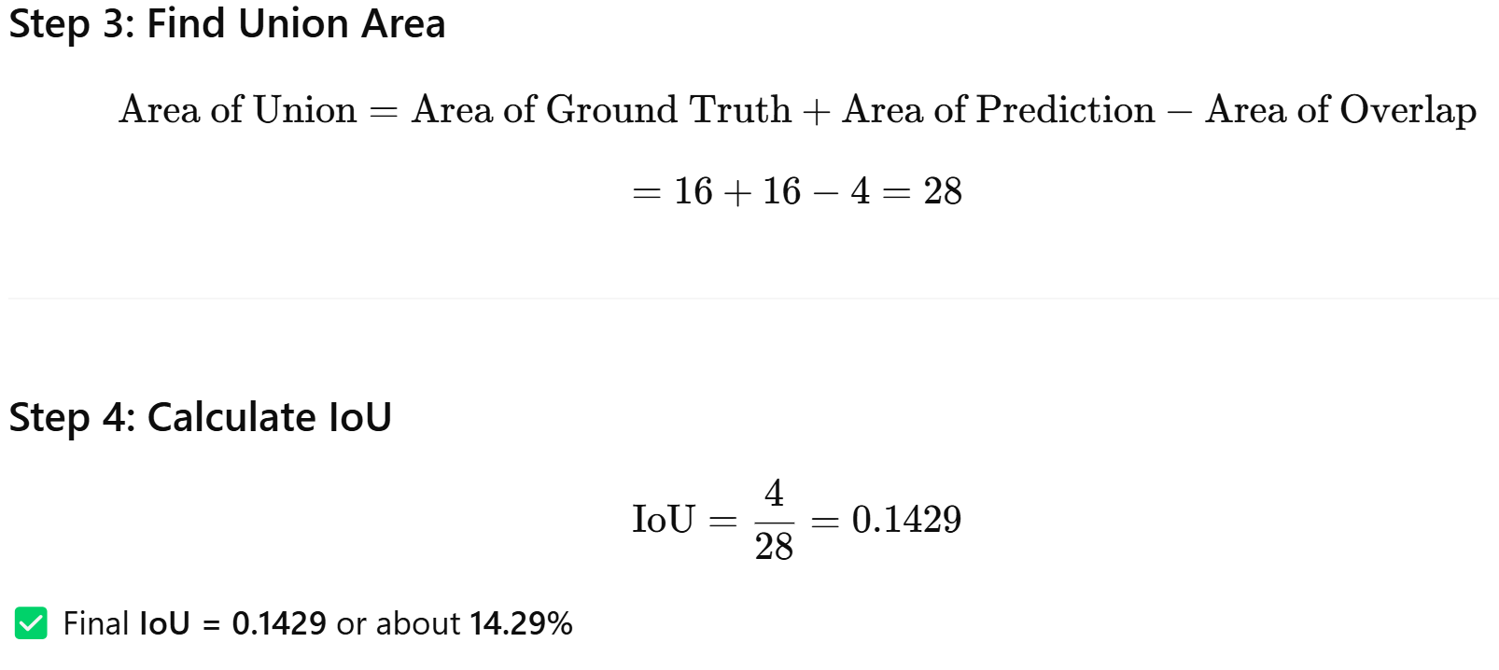
Evaluating Object Detection Models
Calculation Intersection over union (IoU) Example:

Slide 64
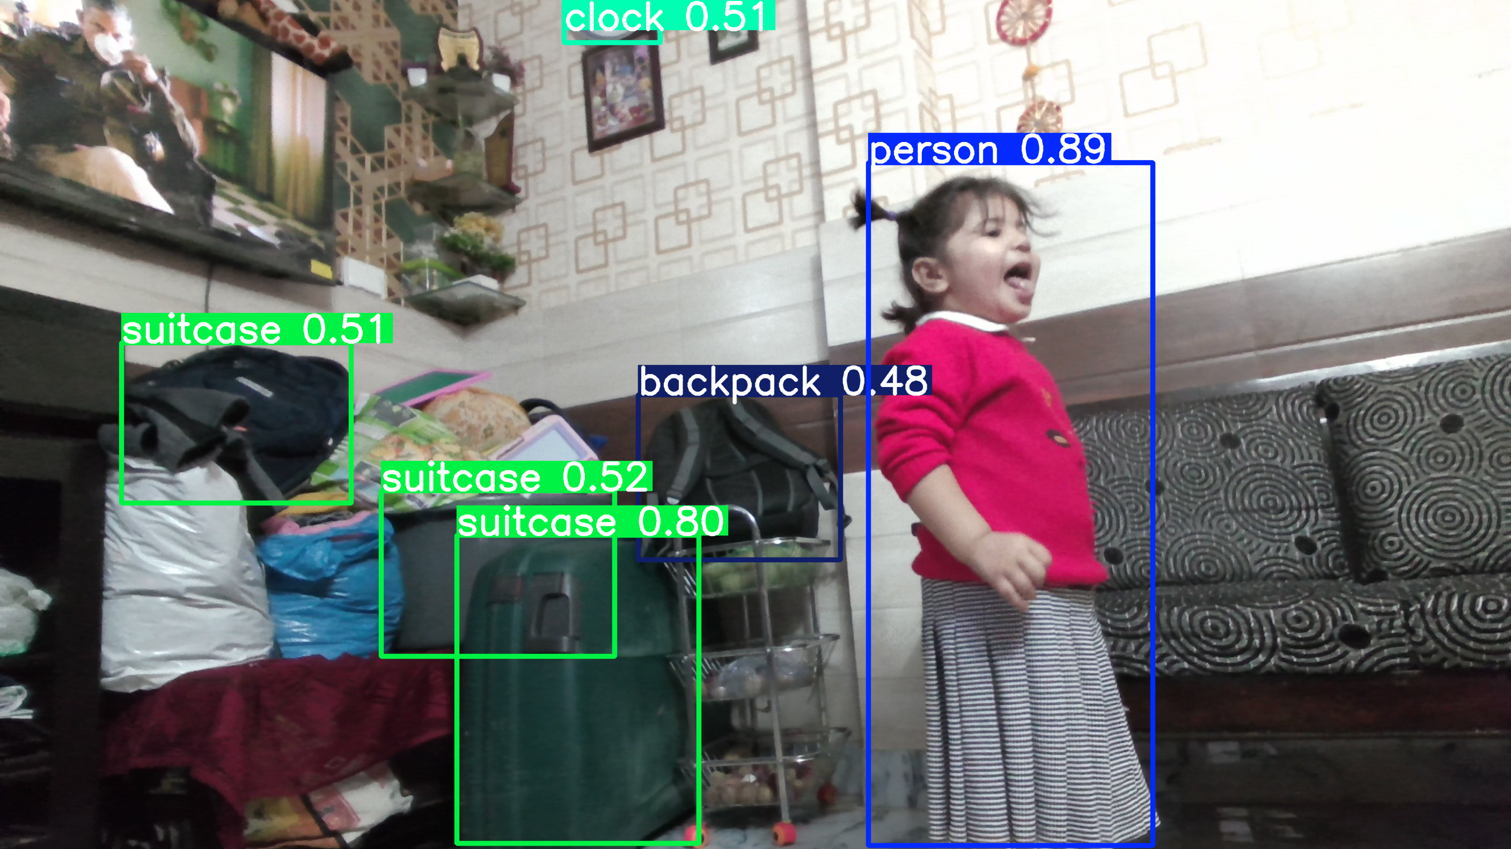
References
https://www.superannotate.com/blog/object-detection-with-deep-learning
Youtube Link: https://www.youtube.com/watch?v=ag3DLKsl2vk
YOLO: https://colab.research.google.com/drive/1ozB3elmUUTmulIsGvhNR3mLNrFz4v6Bb?authuser=1#scrollTo=NnaQB2LiaQe2

